Slide 1

NYC Taxi Fare Prediction

Slide 2
Objective
Understand the factors important in predicting taxi fair.
Develop a machine learning model to forecast taxi fair

Slide 3
Why Does it matter
optimize Pricing strategies
Improves customer satisfaction
Improve operational efficiency

Slide 4
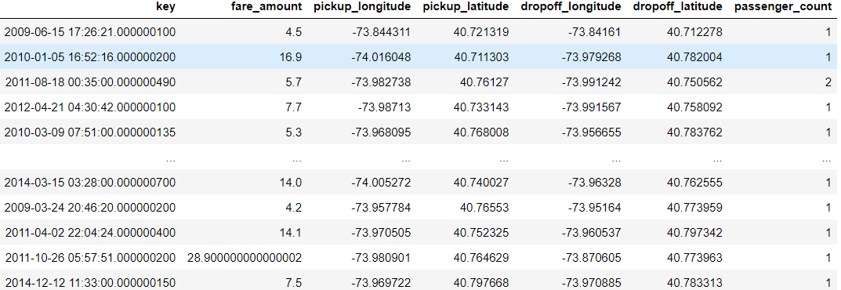
Dataset Overview
Source: https://www.kaggle.com/competitions/new-york-city-taxi-fare-prediction/data
No. of rows: 55 Millions (approx.)
No. of features: 7
Key Features: Pickup_datetime, pickup/dropoff latitude, pickup/dropoff longitude, passenger_count, fare_amount

Slide 5
We will cover
Data Ingestion
Data Cleaning
Exploratory Data Analysis
Hyper parameter tuning
Machine learning model
Feature Engineering

Slide 6
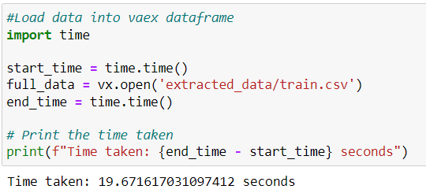
Data Ingestion
Used vaex library to ingest the dataset.
Used last two years data (2014, 2015) for further processing (10 million rows)

Slide 7
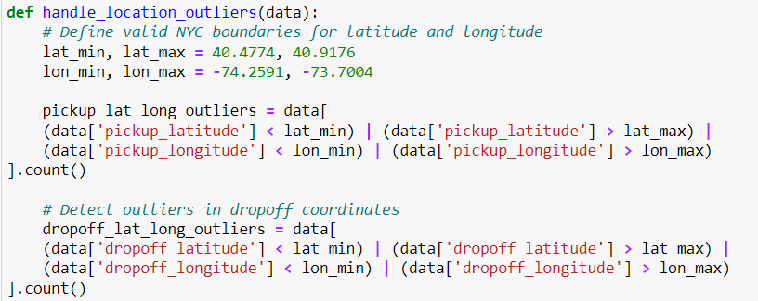
Data Cleaning
Dropped Null values
Removed outliers from fare_amount (FIRST_Q-1.5*IQR and FORTH_Q+1.5IQR)
Removed outliers from passenger_count
Removed outliers from pickup/dropoff locations

Slide 8
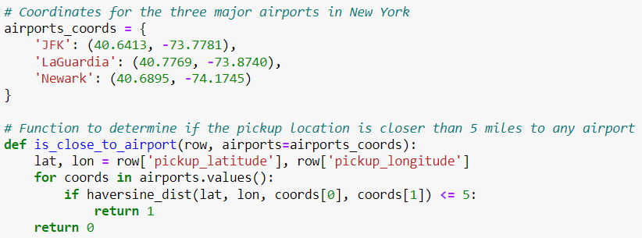
Feature Engineering
Day of the month
Day of the week
Hour
Distance (In miles)
Closer_to_airport

Slide 9
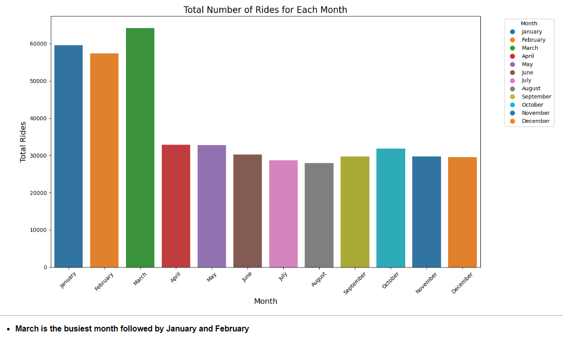
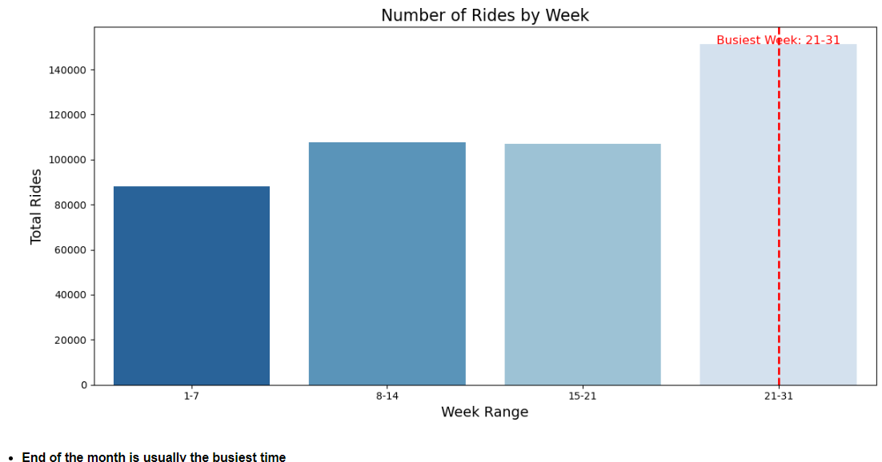
Exploratory Data Analysis

Slide 10
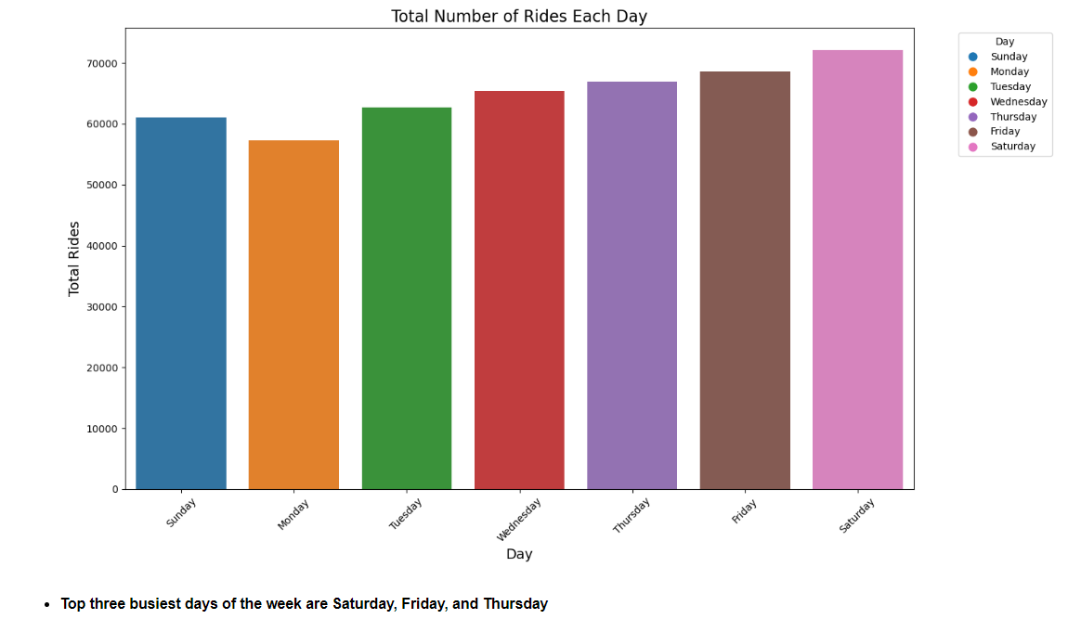
Exploratory Data Analysis

Slide 11
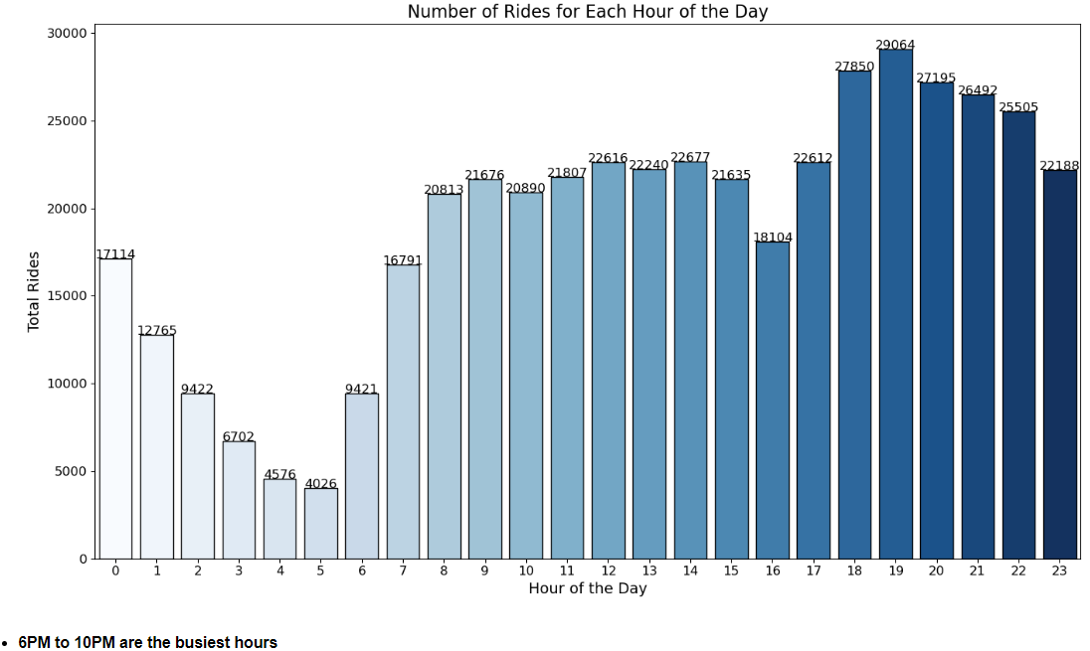
Exploratory Data Analysis

Slide 12
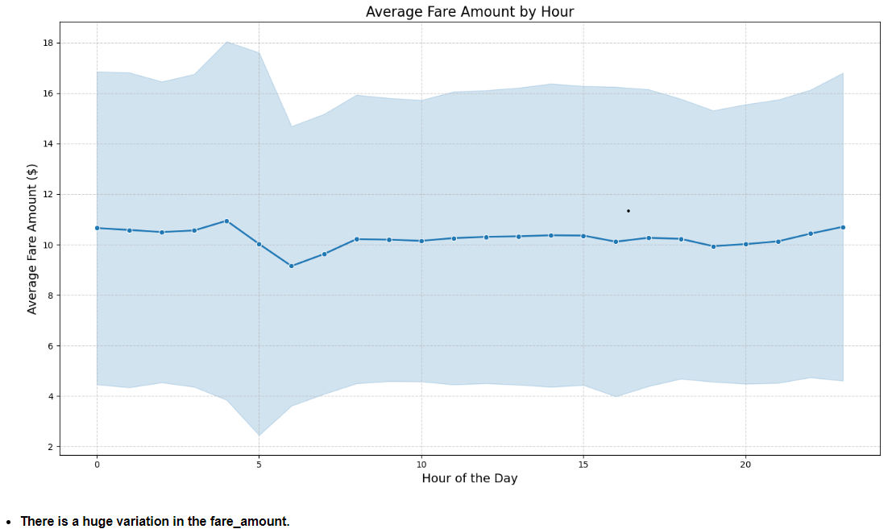
Exploratory Data Analysis

Slide 13
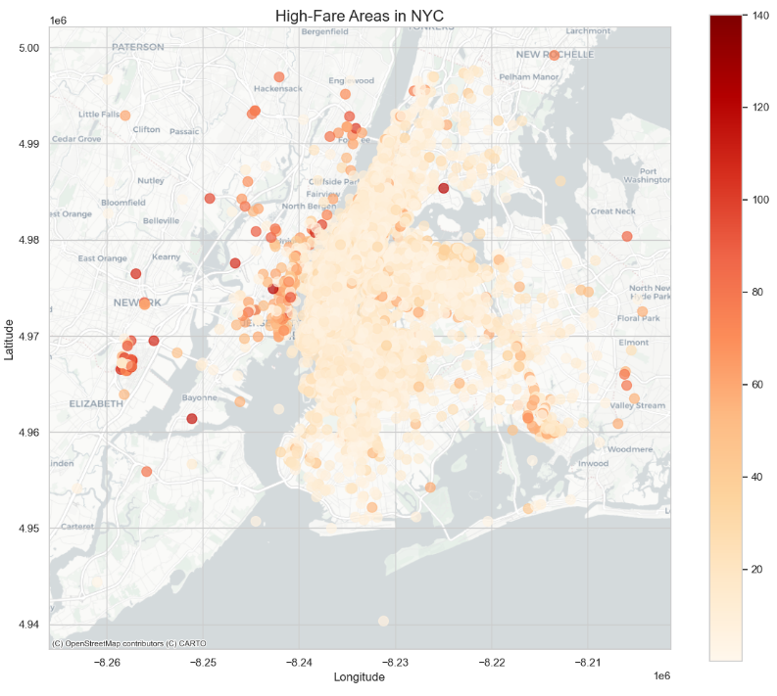
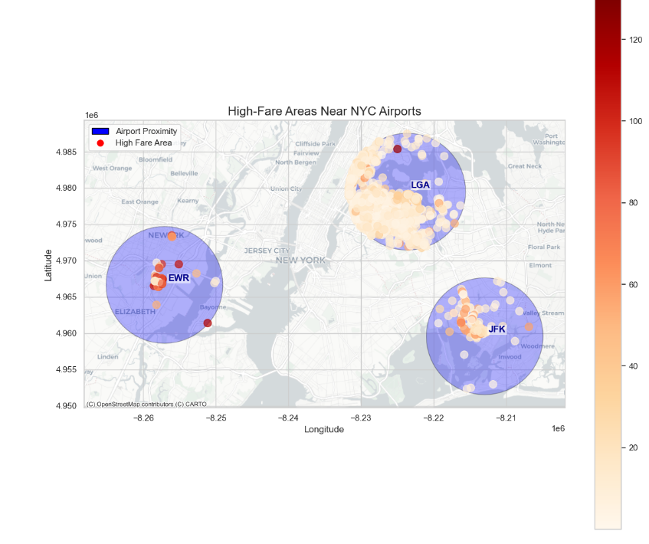
Exploratory Data Analysis

Slide 14
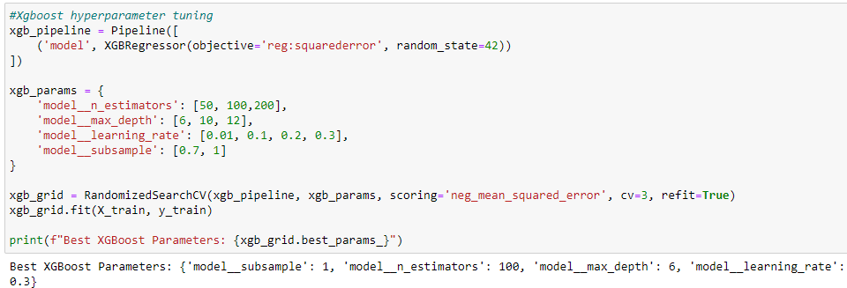
Hyper parameter tuning

Slide 15
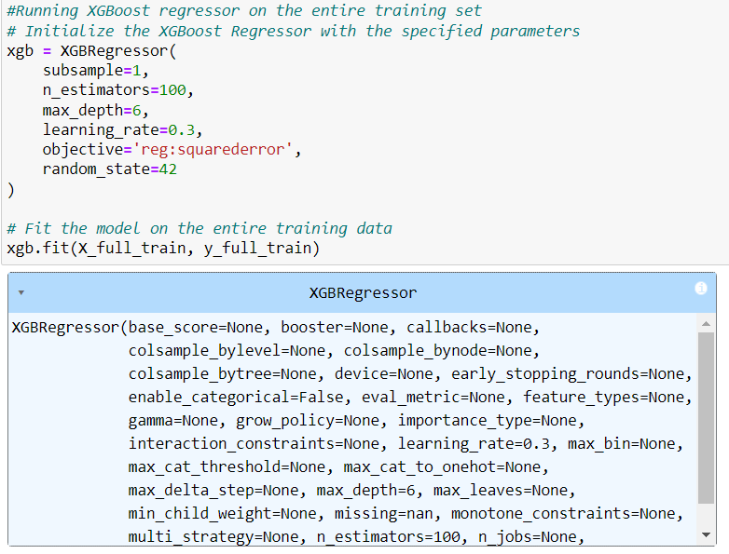
Machine learning model

Slide 16
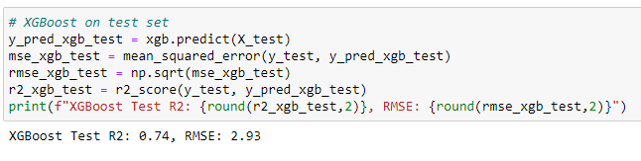
Model Performance

Slide 17
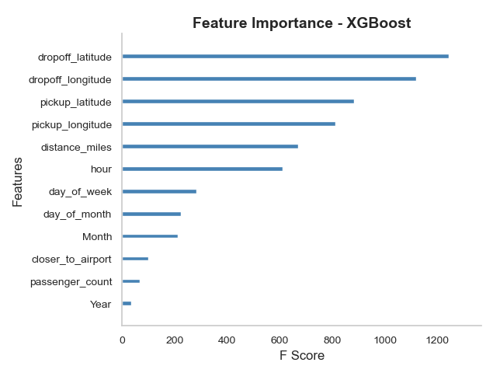
Feature Importance

Slide 18
THANK YOU

